Slide 1
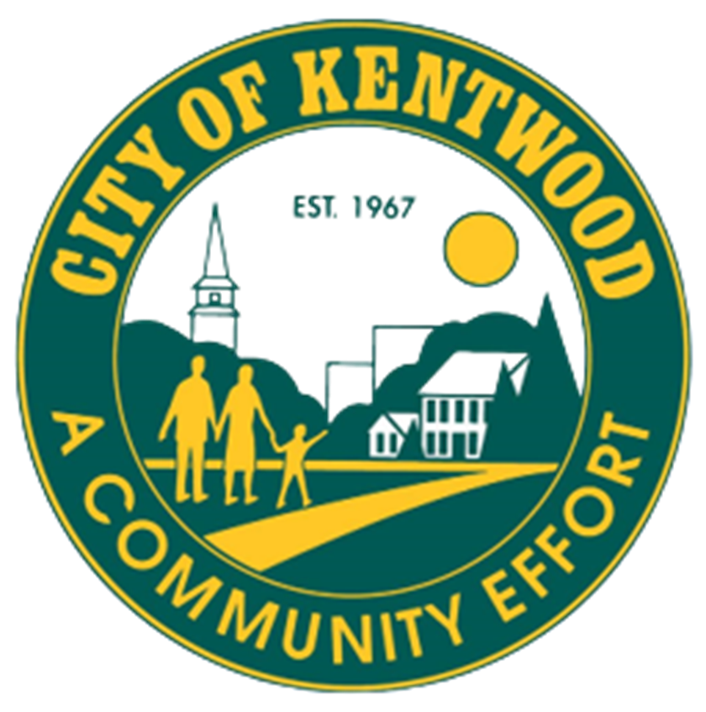
Kentwood
Parks and Recreation Department
New Covenant Park
Feasibility Study

Slide 2
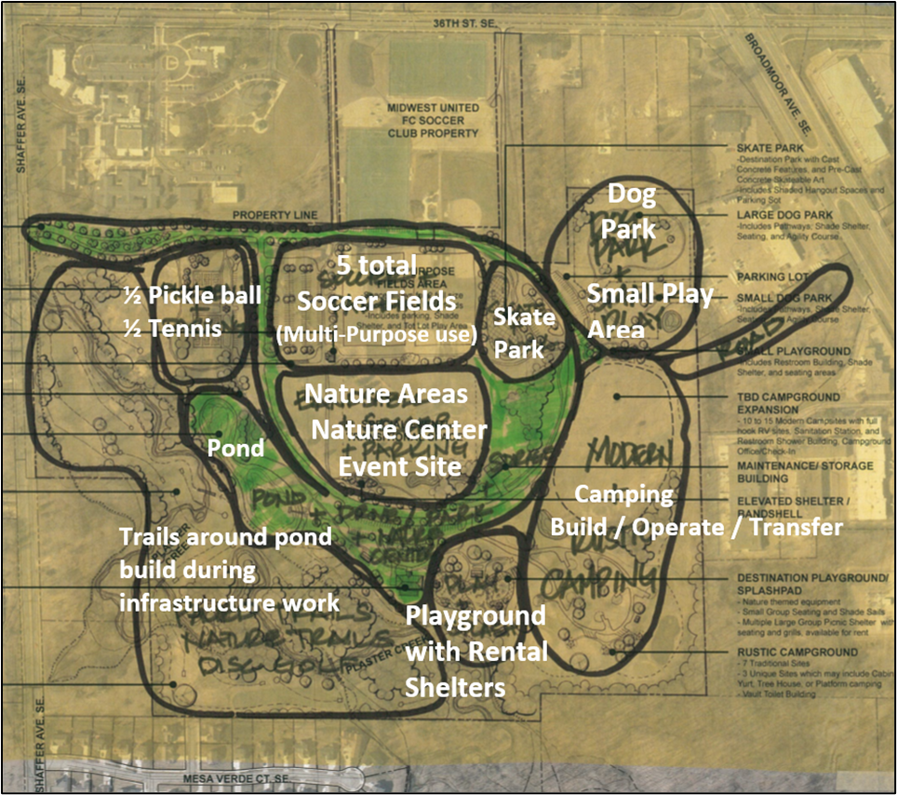
Recommendations for Park Areas

Slide 3
Understanding what the
residents of the
Kentwood Community want in the
New Covenant Park

Slide 4
Surveys
Recreational needs of residents
What Amenities, Programs and Facilities are most important to them
Kentwood Parks are used more by the residents than any other recreation facilities in town.

Slide 5

Participants in the On-line Survey indicated these facilities as most important to them
Disc Golf was first choice (271 participants answered)
Nature Center and Trails (257 participants answered)
Greenspace and Natural Areas (216 participants answered)
Pickleball Courts (141 participants answered)

Slide 6
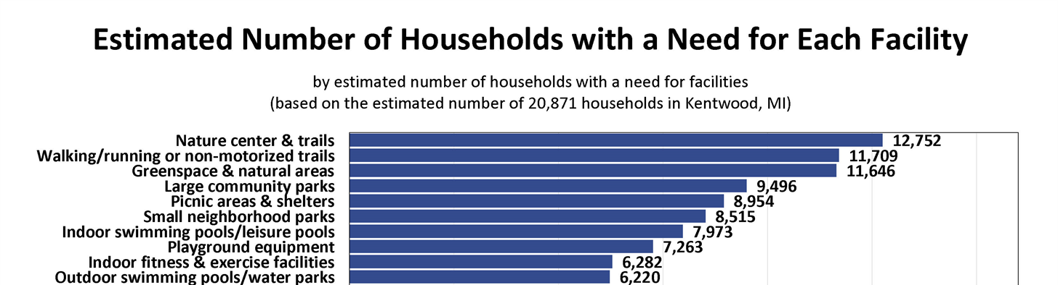
Top 10 Estimated Number of Households
with a Need for a type of Facility

Slide 7
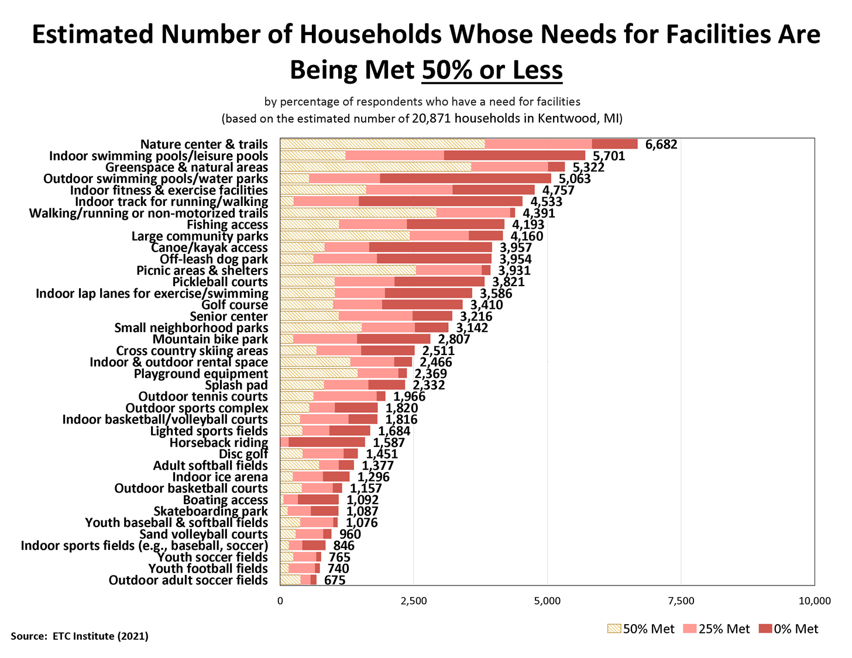
Top 10 Estimated number of Households Whose Needs for Facilities are Being Met by 50% or Less

Slide 9


Kentwood
Parks and Recreation Department

